Slide 1
A comparison of ACF fitting methods
A.J. Ribeiro (1), P.V. Ponomarenko (2), J. M. Ruohoniemi (1), R.A. Greenwald (1), K. Oksavik (3), J.B.H. Baker (1), L.B.N. Clausen (1)
(1) Bradley Department of Electrical and Computer Engineering, Virginia Tech, Blacksburg, Virginia, USA; (2) Institute of Space and Atmospheric Studies, University of Saskatchewan, Saskatoon, Saskatchewan, Canada; (3) Department of Arctic Geophysics, University Centre in Svalbard, Longyearbyen, Norway
SuperDARN Workshop 2011
AJ Ribeiro (Space@VT)
ACF Fitting
SuperDARN 2011

Slide 2
Introduction
Outline
Introduction
Background on SuperDARN ACFs
A brief overview of the 3 methods for fitting ACFS
FITACF
FITEX2
LMFIT
Background on the dataset
Results
Conclusions
AJ Ribeiro (Space@VT)
ACF Fitting
SuperDARN 2011

Slide 3
Background
ACFs
SuperDARN ACFs
Complex autocorrelation functions are calculated fro each range gate from the raw voltages recorded by the receivers
Phase shift between lags (atan(Im/Re)) is fit to determine the Doppler velocity
This can pose a problem, because for velocities in the hundreds of meters per second, the phase from lag 0 to the last lag changes by more than 2π
Decay of the signal is fit to determine the spectral width and power
We will focus on a Lorentzian fit
The magnitude (sqrt(Re^2+Im^2)) is assumed to decay exponentially with time (lag)
A linear least-squares fit is performed on the log of the magnitudes, the slope is the fitted decay, and the y-intercept is the fitted power
Themis -tauscan ACF from 05/18/11 at Goose Bay
AJ Ribeiro (Space@VT)
ACF Fitting
SuperDARN 2011

Slide 4
Fitting Methods
FITACF
FITACF
Standard for SuperDARN ACF fitting
Developed by numerous people over the years
Very fast
Phase shifts of the first few lags is used to make a guess at the number of 2π phase skips that occur throughout the entire ACF
Velocity is fitted with this guess
For the Lorentzian fit, power and spectral width are determined with a linear least-square fit to the log of the lag magnitudes
AJ Ribeiro (Space@VT)
ACF Fitting
SuperDARN 2011

Slide 5
Fitting Methods
FITEX2
FITEX2
FITEX originally developed by Ray Greenwald and Kjellmar Oksavik in order to fit tauscan data
Slower than FITACF
The Lorentzian power and spectral width fits are done the same way as FITACF
Velocity fitting is done differently
Instead of guessing at the 2π phase skips, it fits the “sawtooth” pattern by comparing the ACF phase variation with 120 model phase variations in 1.5° increments
This only provided ~25 m/s resolution on resolved velocities
FITEX2 was developed, which used the best model phase variation as an initial guess, and applied the bisection method to gain arbitrary resolution
Also was expanded for application to non-tauscan data
AJ Ribeiro (Space@VT)
ACF Fitting
SuperDARN 2011

Slide 6
Fitting Methods
LMFIT
LMFIT
In 2008, Ponomarenko et al. used the Levenberg-Marquardt method to fit mixed-scatter ACFs
The L-M method is an algorithm that can be used to perform a non-linear least-squares fit
It is capable of fitting magnitude, decay time, and Doppler frequency of the ACF simultaneously, with no worry of 2π phase skips
$R\left(τ\right)=R_{0}e^{−\frac{τ}{τ_{d}}}e^{j2πτf_{d}}$
We used the free C library MPFIT to perform the L-M method
AJ Ribeiro (Space@VT)
ACF Fitting
SuperDARN 2011

Slide 7
Dataset
Background
Dataset
In order to asses the performance of the 3 methods, we need to know what the correct answer actually is
A simulated dataset was used
100000 ACFS were generated with NAVE=78 and lag 0 power normalized to 1
Old pulse sequence: 0,9,12,20,22,26,27
Velocity in steps of 100 from 50 m/s to 1950 m/s
Decay time in steps of .01 s from .01 s to .1 s
500 samples at each step
Bad lags calculated based on 100 range gates
AJ Ribeiro (Space@VT)
ACF Fitting
SuperDARN 2011

Slide 8
Results
Results 1
Results
Velocity Error | Mean Error (%) | Median Error (%)
FITACF | 2.42 | 0.475
FITEX2 | 2.14 | 0.495
LMFIT | 1.51 | 0.455
Width Error | Mean Error (%) | Median Error (%)
FITACF | 16.1 | 13.7
FITEX2 | 16.2 | 13.8
LMFIT | 14.9 | 12.7
ACF Error (RMS) | Mean Error | Median Error
FITACF | 0.082 | 0.069
FITEX2 | 0.075 | 0.069
LMFIT | 0.072 | 0.068
AJ Ribeiro (Space@VT)
ACF Fitting
SuperDARN 2011

Slide 9
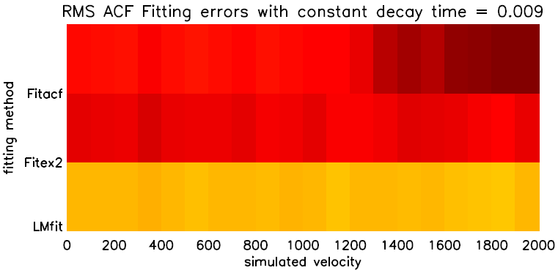
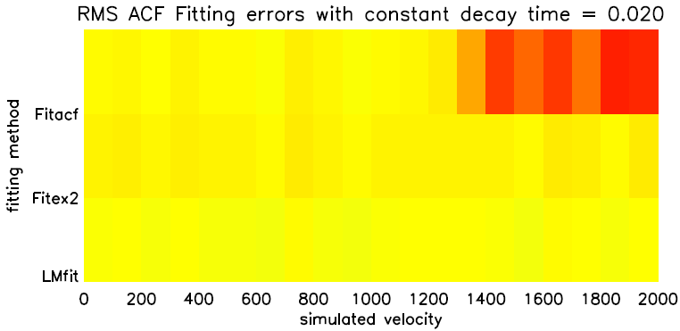
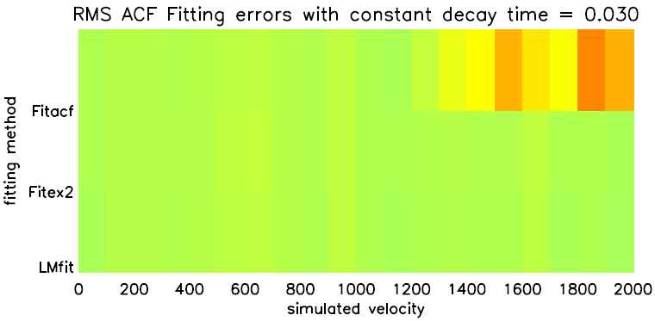
Results
Results 2
Velocity vs. ACF Error
For FITEX2 and LMFIT, ACF fitting error does not increase with velocity
For FITACF, velocity error does not seem to increase with velocity, until about 1 km/s, where the error spikes
For all 3, there is an apparent increasing error with lower decay times (increasing spectral width)
AJ Ribeiro (Space@VT)
ACF Fitting
SuperDARN 2011

Slide 10
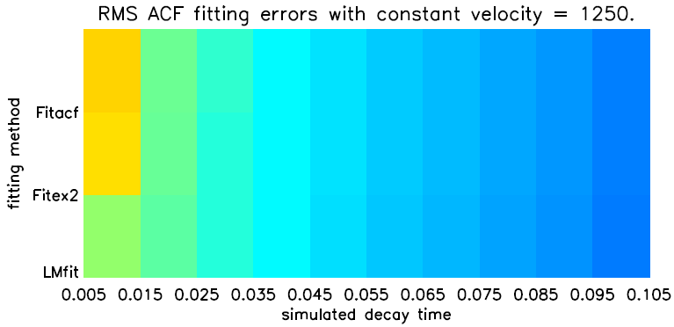
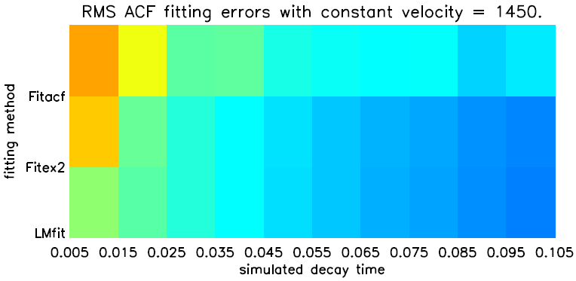
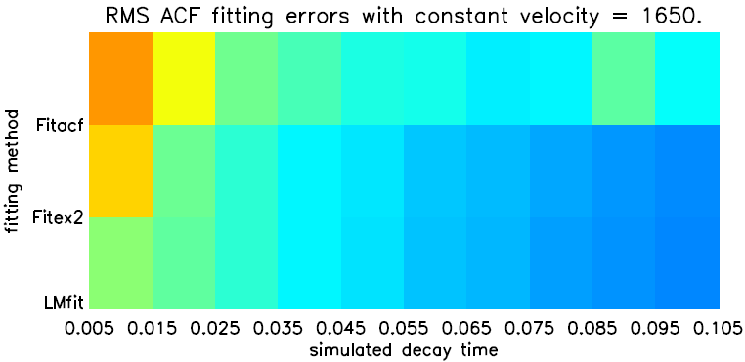
Results
Results 3
Decay Time vs. ACF Error
As was implied by the previous slides, ACF error indeed increases with decreasing decay time
LMFIT produces the best results until τ_{d} ~ .03 (spectral width ~ 130 m/s)
After this point, LMFIT and FITEX2 produce very similar results
FITACF also produces very similar results, until the velocity becomes sufficiently high (~ 1 km/s)
AJ Ribeiro (Space@VT)
ACF Fitting
SuperDARN 2011

Slide 11
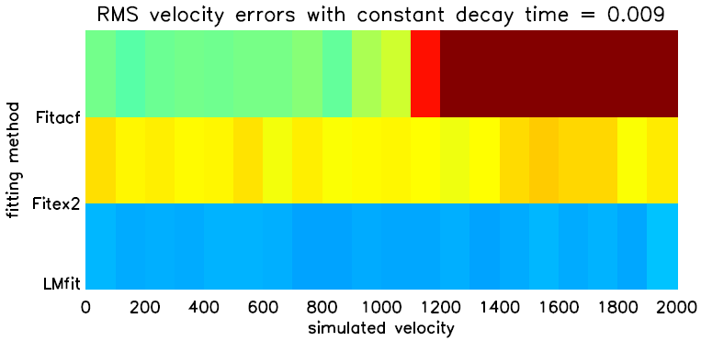
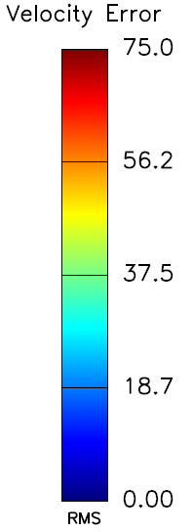
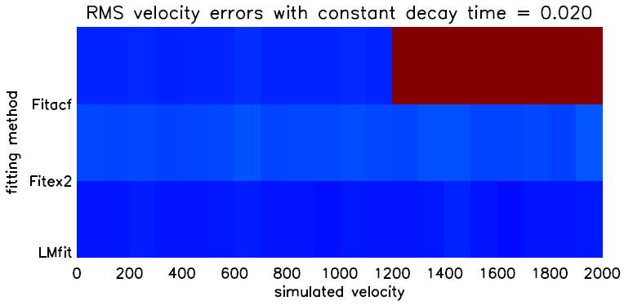
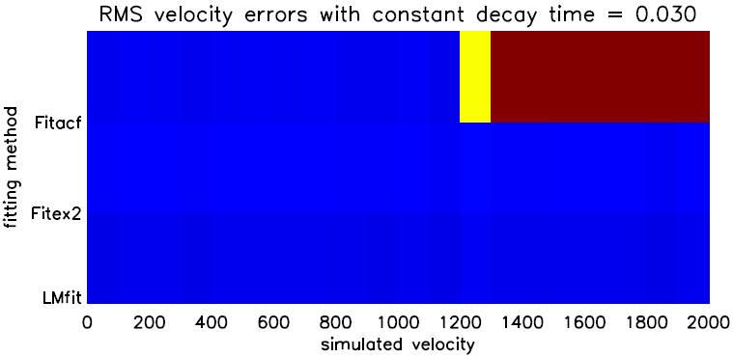
Results
Results 4
Velocity vs. Velocity Error
Again, error for LMFIT and FITEX2 is not affected by increasing velocity
Again, FITACF is also stable until v > ~ 1 km/s
Outperforms FITEX2 for v < 1km/s until τ_{d} ~ .03
It appears that decreasing decay time lowers the velocity at which FITACF begins having issues
Decreasing decay time increases error for all 3 methods
AJ Ribeiro (Space@VT)
ACF Fitting
SuperDARN 2011

Slide 12
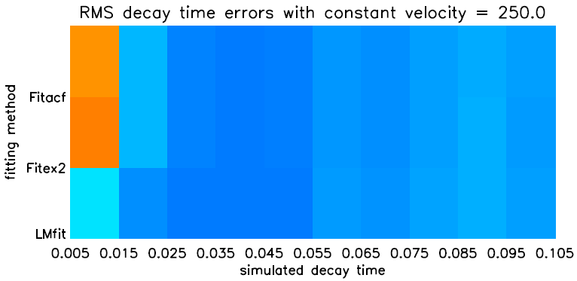
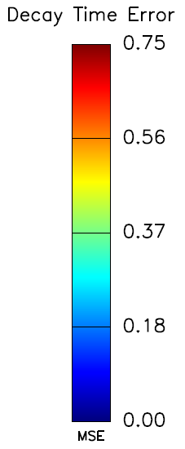
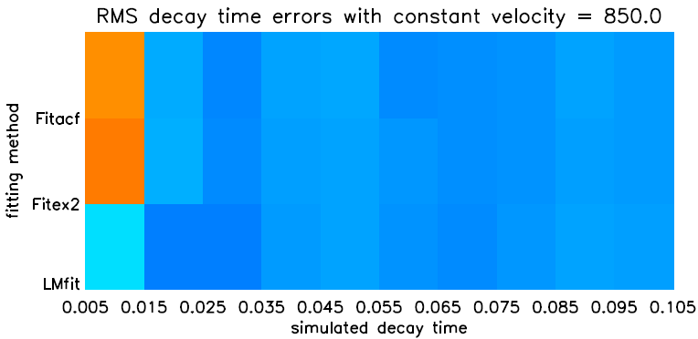
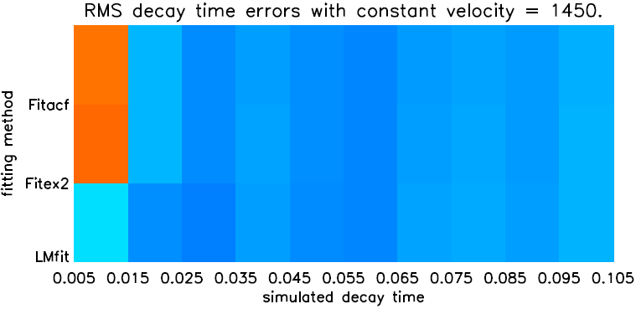
Results
Results 5
Decay Time vs. Decay Time Error
Yet again, error increases with decreasing decay time
FITACF and FITEX2 are very comparable
This makes sense, since the fitting method is the same
LMFIT outperforms the other 2 methods until τ_{d} ~ .03
After this, they all seem to stabilize
Increasing velocity does not appear to cause an increase in decay time error
AJ Ribeiro (Space@VT)
ACF Fitting
SuperDARN 2011

Slide 13
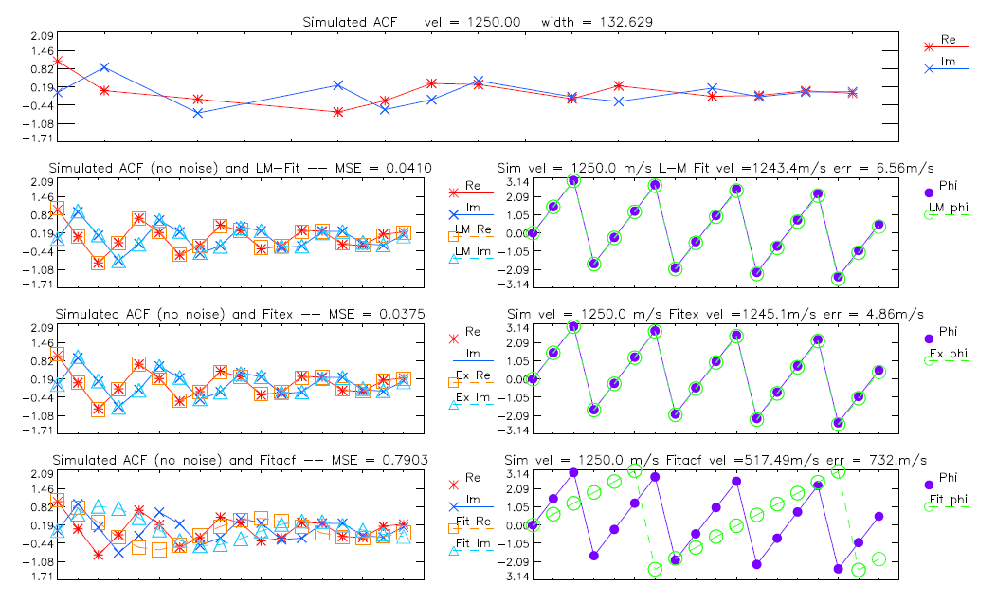
Results
Results 6
What’s going on?
In general, LMFIT outperforms both FITEX2 and FITACF, as shown by mean and median errors
Sometimes, only slightly
FITACF has an added problem at high (> 1 km/s) velocities
If one of the first few lags is bad, it does not get a good guess at the number of 2π phase jumps
If this occurs, FITACF will get a very bad fit for the velocity
AJ Ribeiro (Space@VT)
ACF Fitting
SuperDARN 2011

Slide 14
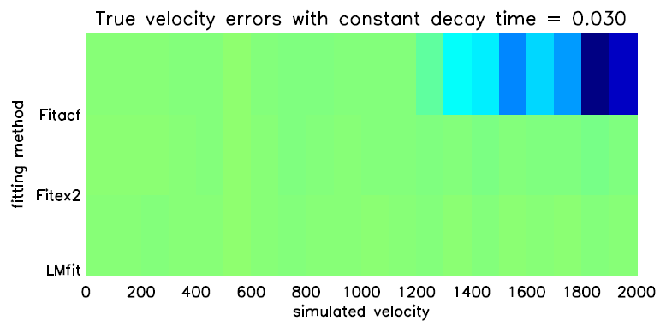
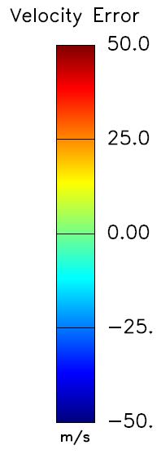
Results
Results 7
One more look…
This shows “true” (signed) velocity error
FITEX2 and LMFIT average out to 0 across all errors (no bias)
FITACF also has no bias, until velocity increases above the point where it can’t get a good guess at 2π phase skips
After this point, it is biased low
AJ Ribeiro (Space@VT)
ACF Fitting
SuperDARN 2011

Slide 15
Conclusions
Conclusions
FITACF is great for the amount of time it takes
1 full day of Themis-tauscan data takes ~ 10 seconds to process
FITACF is the most suitable method for fitting ACFs during runtime at the radars
FITEX2 is capable for fitting velocities without bias and with reasonable errors, but it is slower
1 full day of Themis-tauscan data takes ~ 15 seconds to process
LMFIT outperforms the other 2 methods across all tests, but is the slowest option
1 full day of Themis-tauscan data takes ~ 60 seconds to process
Not suitable for runtime
In an environment when processing time is not a significant concern, LMFIT is the best option for the processing of RAWACF files
Code also can be optimized to decrease processing time
AJ Ribeiro (Space@VT)
ACF Fitting
SuperDARN 2011

Slide 16
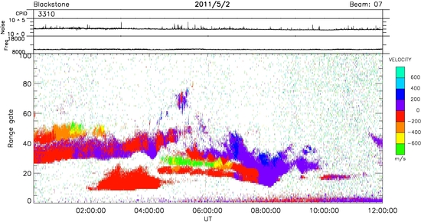
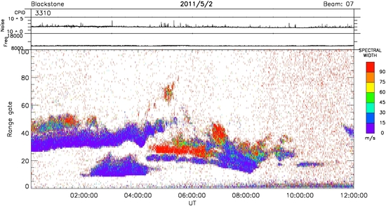
Conclusions
Questions?
AJ Ribeiro (Space@VT)
ACF Fitting
SuperDARN 2011

Slide 17
References
References
Ponomarenko, P. V., C. L. Waters, F. W. Menk, (2008), Effects of mixed scatter on SuperDARN convection maps, Ann. Geophys., 26, 1517-1523, doi:10.5194/angeo-26- 1517-2008.
AJ Ribeiro (Space@VT)
ACF Fitting
SuperDARN 2011

